Slide 1

Mini Project (KCA353) Odd Semester Session 2024-25
<Project Title>
<Team Leader Name and University Roll Number>
<Member Name and University Roll Number>
Project Supervisor:
Supervisor Name
Designation

Slide 2
Content
Introduction (1 slide)
Literature Review (2 slides)
Objective of the Project (1 slide)
Technology
Hardware Requirements (Development Environment, Server requirement (if required), Client requirement (if required).
Software Requirements (Language and Platforms like Frameworks, VS code, Android Studio and Jupyter notebook etc. )
Modules (2-3 slides)
Workflow (1 slide)
Reports (For Example: Project : Student Monitoring System, so reports like: Student Marks, Subjects, companies visit, and student appears in placement etc.)
References (1 slide)
Notes:
Font Styles: Times New Roman + Font Size: 25

Slide 3
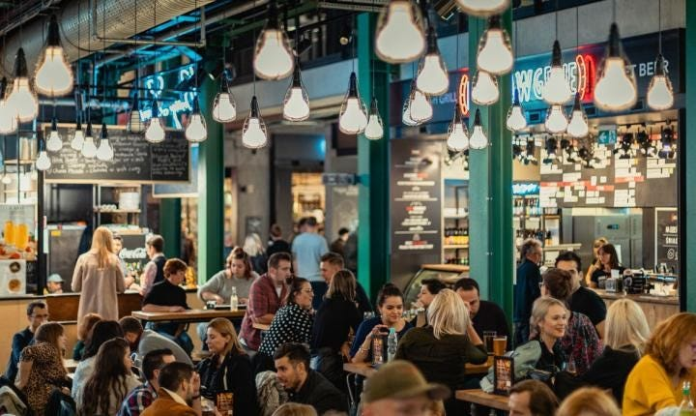
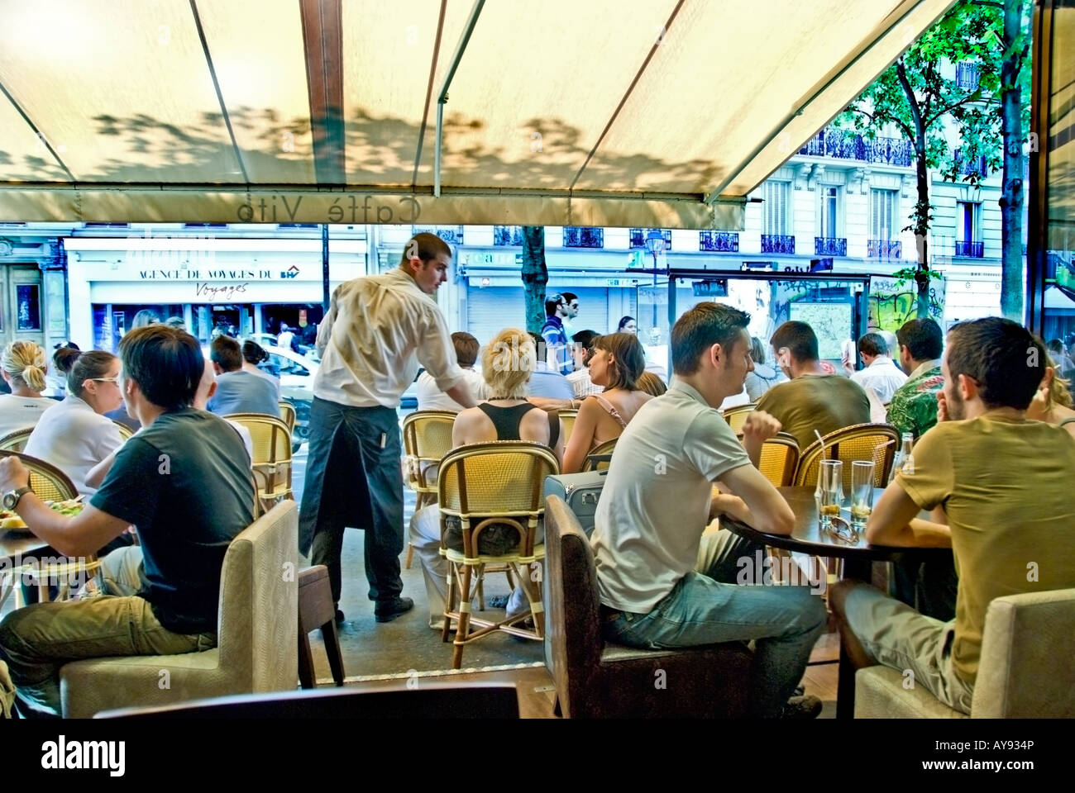
Introduction
As a restaurant owner, managing large crowds during peak hours can be hectic. To address this issue, We developed a Food Ordering Website specifically designed to streamline the ordering process and enhance customer experience. The website provides a convenient platform for customers to browse the menu, place their orders online, and either pick up their food or have it delivered.
Now i optimize kitchen workflow, and minimizes wait time. This system helps ensure that customers enjoy a smoother and more efficient dining experience, even during busy periods that enabling better crowd control.
Notes:
Font Styles: Times New Roman + Font Size: 25

Slide 4
Literature Review
Notes:
Font Styles: Times New Roman + Font Size: 25

Slide 5
Literature Review (Contd.)
Notes:
Font Styles: Times New Roman + Font Size: 25

Slide 6
Objective of the Project
User-Friendly Interface
Restaurant Management Integration
Multiple Payment Options
Security and Privacy
Order History and Recommendations
Notes:
Font Styles: Times New Roman + Font Size: 25

Slide 7
Technology (Hardware Requirements)
Processor (CPU): Dual-core processor (e.g., Intel i3 or AMD equivalent)
RAM: 4 GB Note: This is suitable for small projects, but may result in slower performance when running multiple services simultaneously (MongoDB, Node.js, etc.).
Storage (HDD/SSD): 20 GB free space (SSD preferred for faster performance, especially for database access)
Notes:
Font Styles: Times New Roman + Font Size: 25

Slide 8
Technology (Software Requirements)
Operating System: Windows
Text Editor/IDE:
VS Code (with Prettier, GitLens extensions)
Node.js and npm:
npm (comes with Node.js
MongoDB (for local development) or MongoDB Atlas (cloud service)
MongoDB Compass (optional, for GUI database management)
GitHub: (for remote repositories)
Browser: Google Chrome
Notes:
Font Styles: Times New Roman + Font Size: 25

Slide 9
Modules
Technology (Software Requirements)
MERN Stack Libraries:
React.js (npx create-react-app)
Express.js (npm install express)
Mongoose (npm install mongoose)
API Testing Tools:
Postman or Thunderx (for API testing)
Notes:
Font Styles: Times New Roman + Font Size: 25

Slide 10
Modules (Contd.)
Notes:
Font Styles: Times New Roman + Font Size: 25

Slide 11
Workflow/Gantt Chart
Notes:
Font Styles: Times New Roman + Font Size: 25

Slide 12
Reports
Notes:
Font Styles: Times New Roman + Font Size: 25

Slide 13
References
Notes:
Font Styles: Times New Roman + Font Size: 25

